Slide 1
Comparisons of HBV-associated Liver fibrosis with Normal tissue
Margery (Yutian) Liu

Slide 2
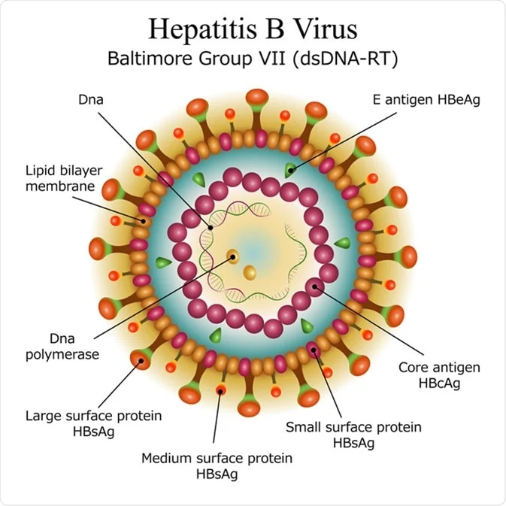
Introduction
Liver fibrosis is the excessive accumulation of extracellular matrix proteins(EMP) including collagen that occurs in most types of chronic liver diseases.
Hepatitis B virus (HBV) is a hepatotropic, enveloped, partially double-stranded DNA virus that causes chronic and acute hepatitis B infections in humans.
Ref: Diagram of Hepatitis B virus particle structure. Image Credit: Moonnoon / Shutterstock

Slide 3
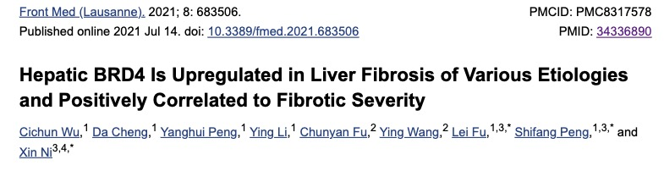
Types of Tissue Used
CXCL6
Liver Tissues :
Eight patients who underwent surgical resection for the treatment of HBV-associated liver cancer in the liver fibrosis group (n = 4) or hemangioma in the control group (n = 4)
Ref: Wu C, Cheng D, Peng Y, et al. Hepatic BRD4 Is Upregulated in Liver Fibrosis of Various Etiologies and Positively Correlated to Fibrotic Severity. Front Med (Lausanne). 2021;8:683506. Published 2021 Jul 14. doi:10.3389/fmed.2021.683506

Slide 4
Priori Hypothesis
Inflammation is a major contributor to the pathogenesis of almost all liver diseases.
Low-molecular-weight proteins called chemokines are the main drivers of liver infiltration by immune cells such as macrophages, neutrophils and others during an inflammatory response.
CXC- motifs are expected to be upregulated in the liver fibrosis group.

Slide 5
Sequencing Source
Total RNA Extracted -- the RNeasy Mini Kit
Generate Sequencing Libraries -- UltraTM RNA Library Prep Kit for Illumina
150 bp paired-end reads were generated
2 FASTQ files for each sample
8 patients
Liver Fibrosis Group(n=4): HBV-associated
Control Group(n=4)
Sequencing data source: (GEO: GSE171294)
Sequencing reads: Paired end
Samples | Group | Single or Paired End | SRA
GSM5222239 | Normal Control 1 | Paried End | SRX10498444
GSM5222240 | Normal Control 2 | Paried End | SRX10498445
GSM5222241 | Normal Control 3 | Paried End | SRX10498446
GSM5222242 | Normal Control 4 | Paried End | SRX10498447
GSM5222243 | LIver Fibrosis 1 | Paried End | SRX10498448
GSM5222244 | LIver Fibrosis 2 | Paried End | SRX10498449
GSM5222245 | LIver Fibrosis 3 | Paried End | SRX10498450
GSM5222246 | LIver Fibrosis 4 | Paried End | SRX10498451

Slide 6
Pre-alignment sequencing metrics
Maximum (M) | LF1 | 23.634002
Minimum (M) | LF4 | 20.642325
Average (M) | 22.31673575
Liver Fibrosis
Normal Control

Slide 7
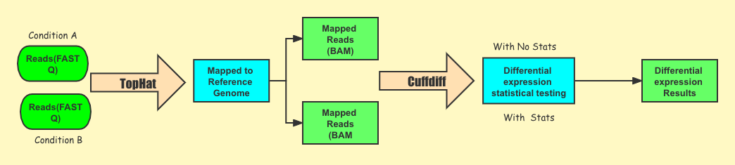
Processing Pipeline
Processing Pipeline
Ref:Homo_sapiens.GRCh38.104.chr.gtf
ensembl.GRCh38.104.fa

Slide 8
Processing Pipeline
 | Alignment | Counting | Differential Gene Expression Analysis
Tool | TopHat 2 | Cuffdiff ((No Stats) | Cuffdiff(With Stats)
Input | FASTQ files | BAM from alignment | BAM from alignment
Output | BAM files | genes.fpkm_tracking | gene.exp_diff
genes.fpkm_tracking : FPKM values for ALL the samples and columns reflect the labels (-L)
gene.exp_diff : statistical tests for two groups and columns reflect the group labels (-L)

Slide 9
Alignment Metrics and Statistics
% Alignment
Maximum (%) | LF2 | 82.4
Minimum (%) | LF4 | 70.1
Average(%) | 78.0875
% Discordance
Maximum % | NC3 | 0.8
Minimum % | LF1/NC4 | 0.3
Average | 0.4875
Liver Fibrosis
Normal Control

Slide 10
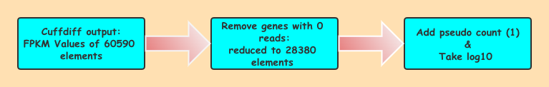
Data Pre-Processing

Slide 11
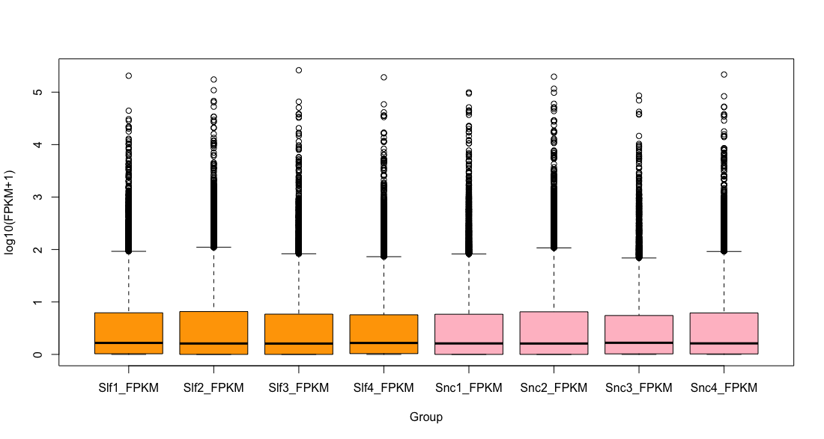
Box Plot : Filter Samples(28380 elements)
Liver Fibrosis
Normal Control

Slide 12
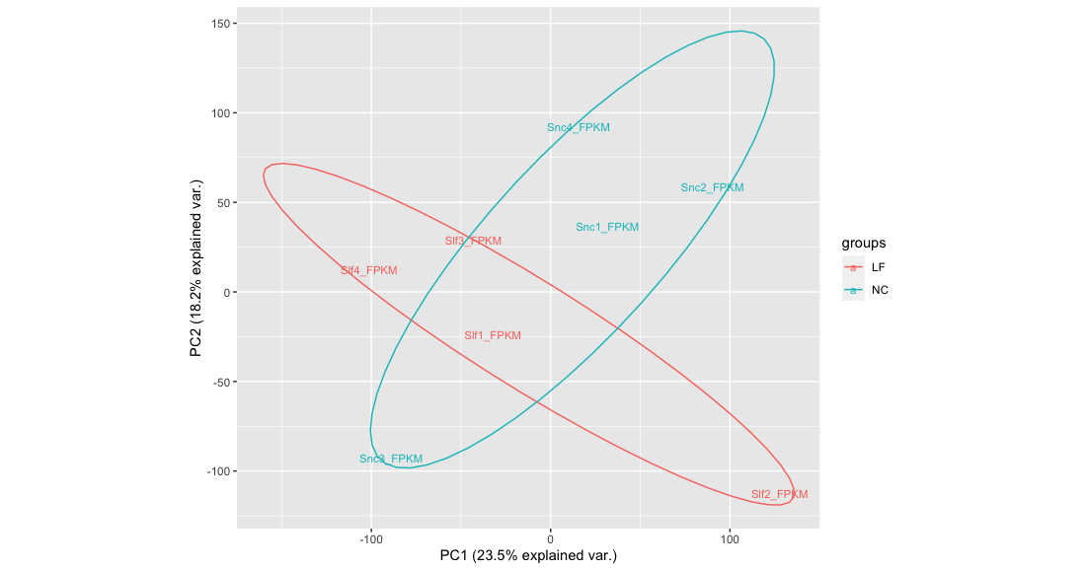
PCA Plot : Filter Samples(28380 elements)

Slide 13
Differential Expression Genes Seletion
ABS(Log2Fold Difference) >= 1.5
P-Value <= 0.01
Result: 216 filtered genes
125 upregulated, 91downregulated

Slide 14
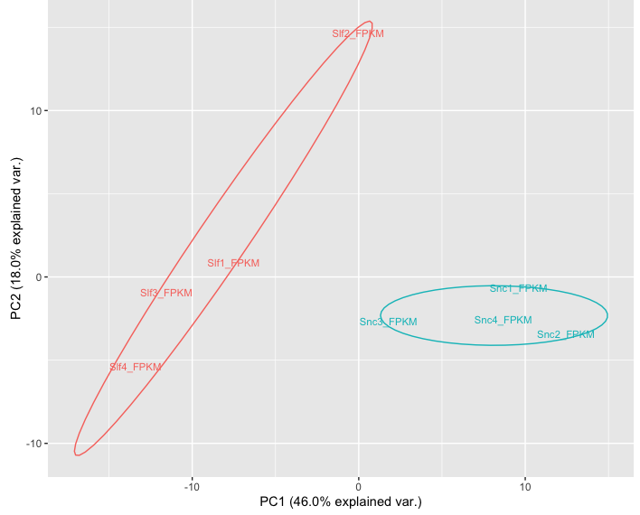
PCA Plot :
Differential Expressed Genes
(DEG : 216 filted genes)

Slide 15
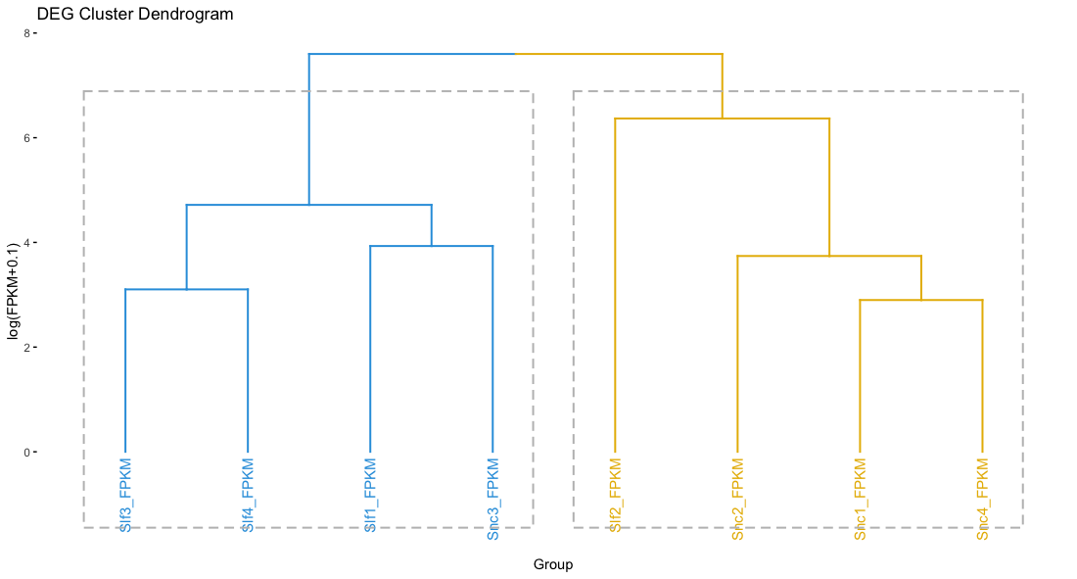
Cluster Dendrogram: Differential Expressed Genes
(DEG : 216 filted genes)
NC3
LF 2
LF 3
LF 1
NC2
NC4
LF 4
NC1

Slide 16
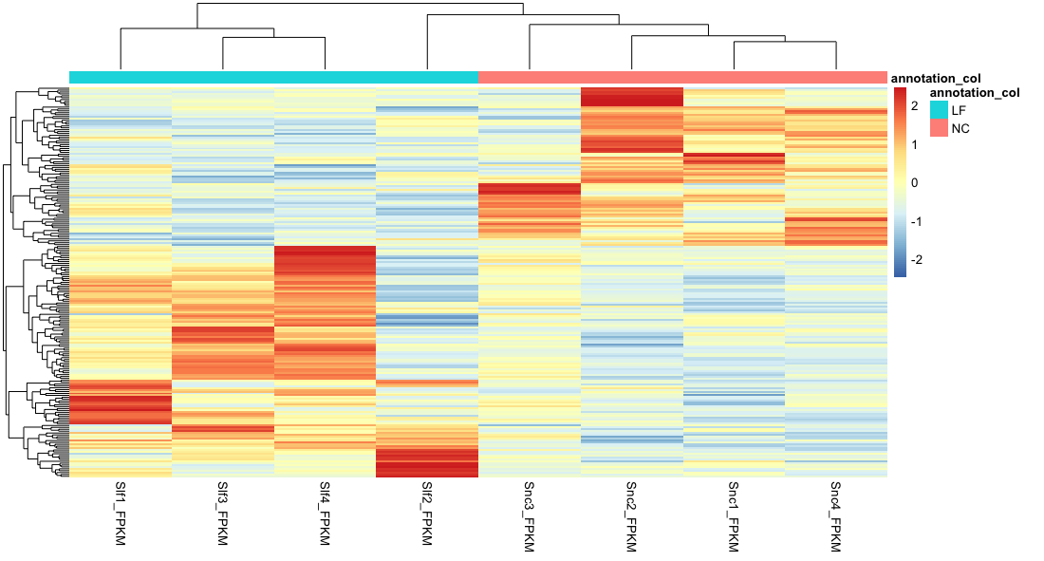
HeatMap : Differential Expressed Genes
(DEG : 216 filted genes)

Slide 17
IPA PATHWAY ANALYSIS
Differential Expressed Genes(DEGs):
pvalue <= 0.5 & abs(log2foldchange >=1.5)
216DEGs: 125 upregulated, 91downregulated
Upregulated Pathway
Disease of Functions Annotation | P-Value | Molecules
Inflammation of Organ | 0.00037 | CD79A,CRP,CXCL10,CXCL13,CXCL6,CXCL9,CXCR3,CXCR4,DUSP2,FAM153A/FAM153B,IGHG1,IGKC,IL32,PDCD1,PLA2G2A,SOCS1,UBD
Consistent with the priori hypothesis CXC- motifs are expected to be upregulated in the liver fibrosis group

Slide 18
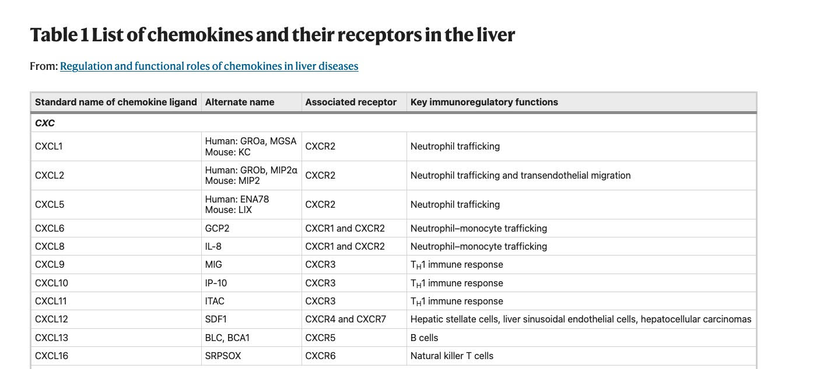
CXCR3 is the associated Receptor of CXCL9 & CXCL10&CXCL11
The anti-fibrotic and anti-angiogenic CXCR3 is the key receptor on T cells, NK cells and possibly HSCs, with CXCL9 , CXCL10, CXCL11 as its ligands in the liver
Ref: Cao, S., Liu, M., Sehrawat, T.S. et al. Regulation and functional roles of chemokines in liver diseases. Nat Rev Gastroenterol Hepatol 18, 630–647 (2021). https://doi.org/10.1038/s41575-021-00444-2

Slide 19
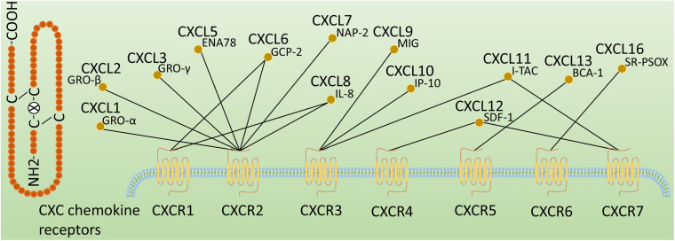
Classification of CXC chemokine receptors
Ref:Wang S, Gao S, Li Y, Qian X, Luan J, Lv X. Emerging Importance of Chemokine Receptor CXCR4 and Its Ligand in Liver Disease. Front Cell Dev Biol. 2021;9:716842. Published 2021 Jul 27. doi:10.3389/fcell.2021.716842

Slide 20
Cuffdiff Results of CXCL11,CXCL10, CXCL9&CXCR3
Gene | Sample1 | Sample2 | Status | Value1 | Value2 | log2(FoldChange) | P-Value
CXCL10 | Liver Fibrosis | Normal Control | OK | 68.3166 | 7.70311 | -3.14872 | 0.00005
CXCL9 | Liver Fibrosis | Normal Control | OK | 56.4557 | 5.66805 | -3.31619 | 0.00115
CXCR3 | Liver Fibrosis | Normal Control | OK | 1.91006 | 0.543254 | -1.81392 | 0.00845
CXCL11 | Liver Fibrosis | Normal Control | OK | 2.55493 | 0.584771 | -2.12734 | 0.2626

Slide 21
Funtion of CXCL9/10/11 in HBV
CXCL9, CXCL10, and CXCL11 are induced by HBV-positive hepatocytes with coexisting NK cells and pDCs, which synergistically produce IFN-α and IFN-γ in response to HBV.
CXCL9 is induced by IFN-γ but not by IFN-α/β. CXCL10 is strongly induced by IFN-γ as well as IFN-α/β . CXCL11 is induced by IFN-γ and IFN-β, and weakly by IFN-α.
CXCL9, CXCL10, and CXCL11 Chemokines can be regarded as Predictors of Liver Fibrosis.
Ref : Yoshio S, Mano Y, Doi H, et al. Cytokine and chemokine signatures associated with hepatitis B surface antigen loss in hepatitis B patients. JCI Insight. 2018;3(20):e122268. Published 2018 Oct 18. doi:10.1172/jci.insight.122268

Slide 22
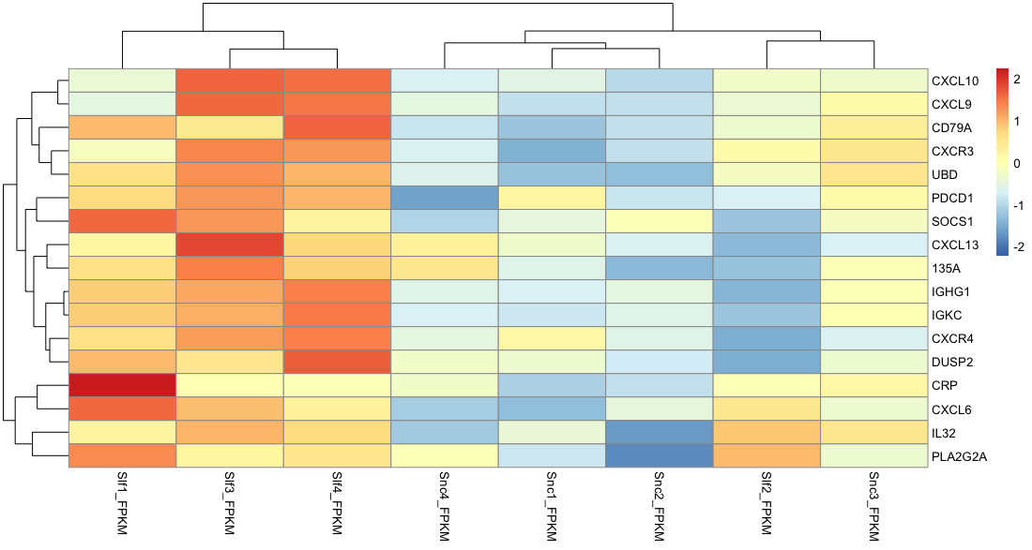
HeatMap of Pathway : Inflammation of Organ
Liver Fibrosis Group

Slide 23
Cuffdiff and FPKM Results of CD79A
Gene | LF1_FPKM | LF2_FPKM | LF3_FPKM | LF4_FPKM | NC1_FPKM | NC2_FPKM | NC3_FPKM | NC4_FPKM
CD79A | 10.423 | 2.98631 | 6.06395 | 19.2448 | 1.29646 | 1.72012 | 5.60079 | 1.76409
Gene | Sample1 | Sample2 | Status | Value1 | Value2 | log2(FoldChange) | P-Value
CD79A | Liver Fibrosis | Normal Control | OK | 10.0787 | 2.96656 | -1.76445 | 0.00025
CD79A | 10.423 | 2.98631 | 6.06395 | 19.2448 | 1.29646 | 1.72012 | 5.60079 | 1.76409

Slide 24
CD79A
The B lymphocyte antigen receptor is a multimeric complex that includes the antigen-specific component, surface immunoglobulin (Ig). Surface Ig non-covalently associates with two other proteins, Ig-alpha and Ig-beta, which are necessary for expression and function of the B-cell antigen receptor. This gene encodes the Ig-alpha protein of the B-cell antigen component. [provided by RefSeq, Jul 2008]
New Hypothesis
CD79A maybe also correlated with liver fibrosis and can possibly be as predictors for HBV

Slide 25
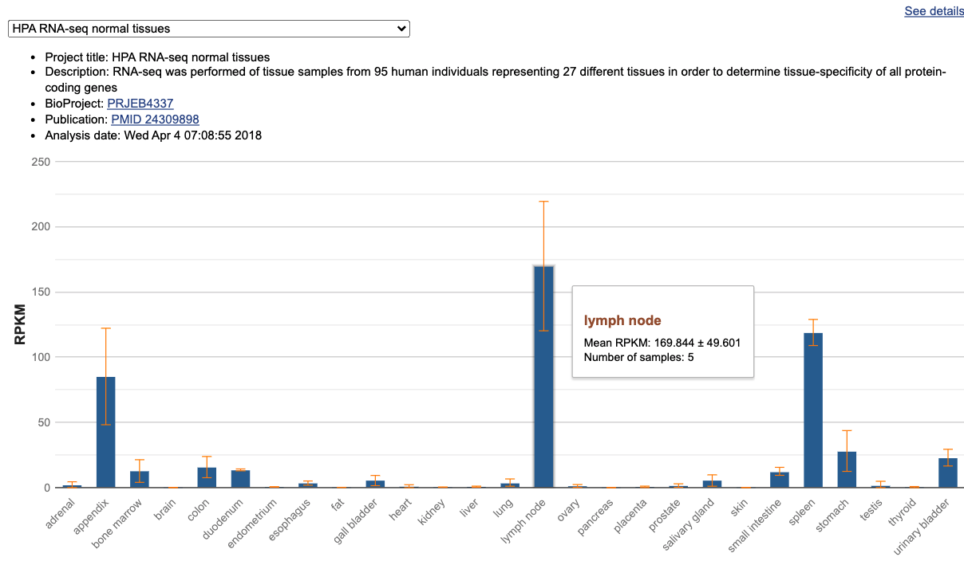
Expression of CD79A in different samples
Ref:https://www.ncbi.nlm.nih.gov/gene/973#gene-expression

Slide 26
Functions of Lymph nodes in Liver Fibrosis
Lymph nodes are well known to exist in the hepatoduodenal ligament.
In ultrasound study, enlarged lymph nodes could be demonstrated in the hilus hepatis of almost all patients with CHB or CHC.
Enlarged lymph nodes can be a good indicator of inflammatory activity by the liver in CHB,especially those wider than 5 mm, suggested chronic HBV or HCV infection.
Several effective medications are available to inhibit HBV replication with liver fibrosis regression by reducing liver inflammation and cellular damage in most patients with chronic hepatitis B (CHB).
The assessment of liver necroinflammatory activity and fibrosis for patients with CHB is helpful for determining prognosis and treatment strategy.
The expression of CD79A might used to evaluated the degree of liver fibrosis
Ref:Shu J, Zhao JN, Han FG, et al. Chronic hepatitis B: Enlarged perihepatic lymph nodes correlated with hepatic histopathology. World J Radiol. 2013;5(5):208-214. doi:10.4329/wjr.v5.i5.208

Slide 27
Summary
Protein anaysis CD79A
Ig-alpha protein of the B-cell antigen component
Immunoassay
The IPA anlysis results show that many pathways related to inflammation are up-regulated.
In the Inflammation of Organ pathway , CXCL9, CXCL10, CXCL11 and CXCR3 are up-regulated which is consistent with previous studies.
In the Inflammation of Organ pathway , CXCL6,PLA2G2A and IL32 are up-regulated which is consistent with previous studies^{[1][2][3]}.
CD79A in the in the Inflammation of Organ pathway is up-regulated similarly as CXCL9, CXCL10, CXCL11 and CXCR3 . It maybe also correlated with liver fibrosis which could be useful for evaluating the degree of patients with liver fibrosis.
[1]Wu C, Cheng D, Peng Y, et al. Hepatic BRD4 Is Upregulated in Liver Fibrosis of Various Etiologies and Positively Correlated to Fibrotic Severity. Front Med (Lausanne). 2021;8:683506. Published 2021 Jul 14. doi:10.3389/fmed.2021.683506
[2]Zhu C, Song H, Shen B, Wu L, Liu F, Liu X. Promoting effect of hepatitis B virus on the expressoin of phospholipase A2 group IIA. Lipids Health Dis. 2017 Jan 11;16(1):5. doi: 10.1186/s12944-016-0400-7. PMID: 28077172; PMCID: PMC5225502.
[3]Xu Q, Pan X, Shu X, Cao H, Li X, Zhang K, Lu J, Zou Y, Li X, Liu H, Zhang Y, Yang D, Ning Q, Shen G, Li G. Increased interleukin-32 expression in chronic hepatitis B virus-infected liver. J Infect. 2012 Oct;65(4):336-42. doi: 10.1016/j.jinf.2012.05.009. Epub 2012 Jun 8. PMID: 22687868.

Slide 28
THANK YOU

